Slide 1
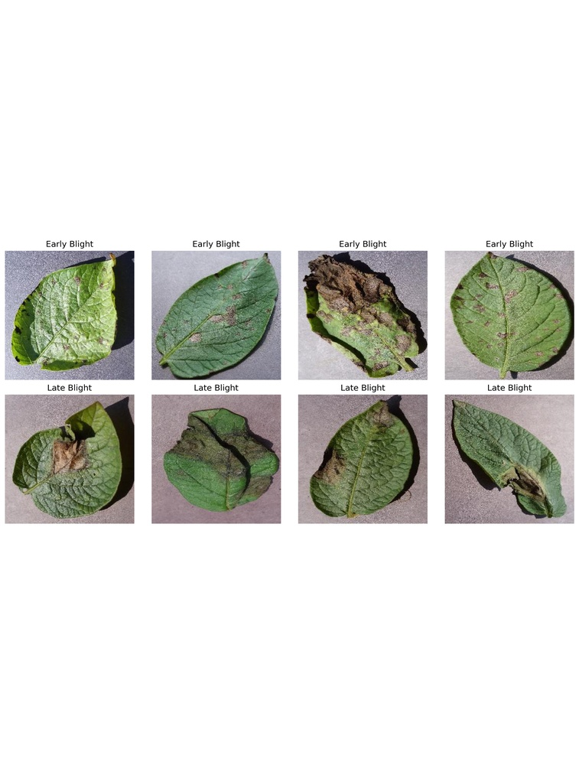
CHARLES DARWIN UNIVERSITY
PRT661 · Data Science Practice
Early vs Late Potato Blight Classification
Group:Dan7– Theme2
Kavya Sree Sunkara - S386025
Mahdi Hasan Abdullah - S394885
Sayed Mahidul Islam Rafel - S387949
Partha Mallik - S392819
Datta Sai Kanaparthi - S385673

Slide 2
PRT661 · DATA SCIENCE PRACTICE
1
Table of Contents
Problem and research question
Balanced dataset and fixed split
Implemented workflow
Three-model design
MobileNetV2 training and checkpoint selection
Primary MobileNetV2 held-out result
Untouched PlantDoc external evaluation
Explainability and internal error review
Validation thresholds and paired evidence
Segmentation exposed a probability shift
Controlled image perturbations
Ablation and efficiency
Feedback-integrated results explorer
Ethics, privacy and security
Implementation status and evidence gaps
Prioritised next steps
Future work before Assessment 4
Conclusion and references

Slide 3
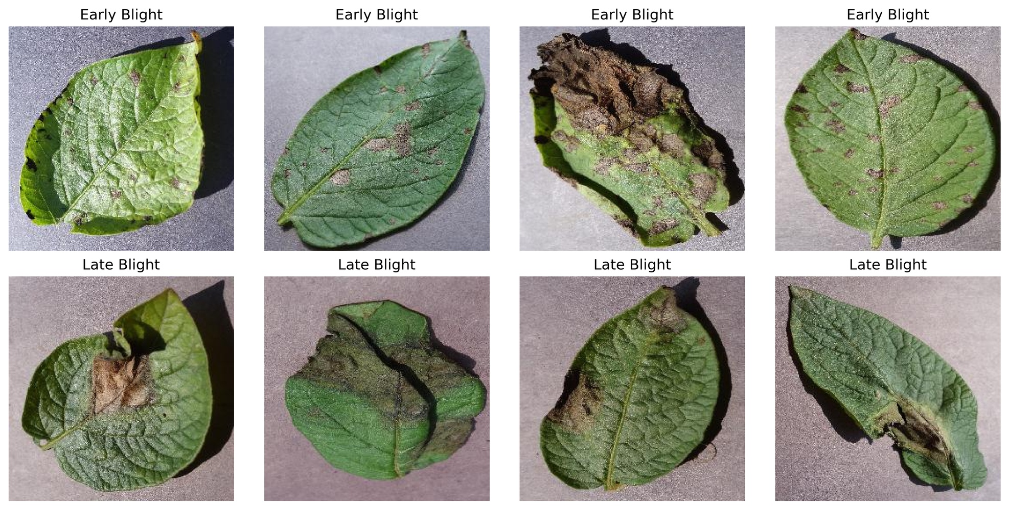
PRT661 · DATA SCIENCE PRACTICE
2
Problem and research question
• Early and Late Blight can produce visually confusing leaf symptoms.
• Random image splitting can overstate performance when multiple images come from the same leaf.
• Question: can leakage-controlled models separate the two labels and retain useful performance on untouched PlantDoc images?
• Scope: Early vs Late Blight only; no Healthy, Other, pesticide or treatment output.

Slide 4
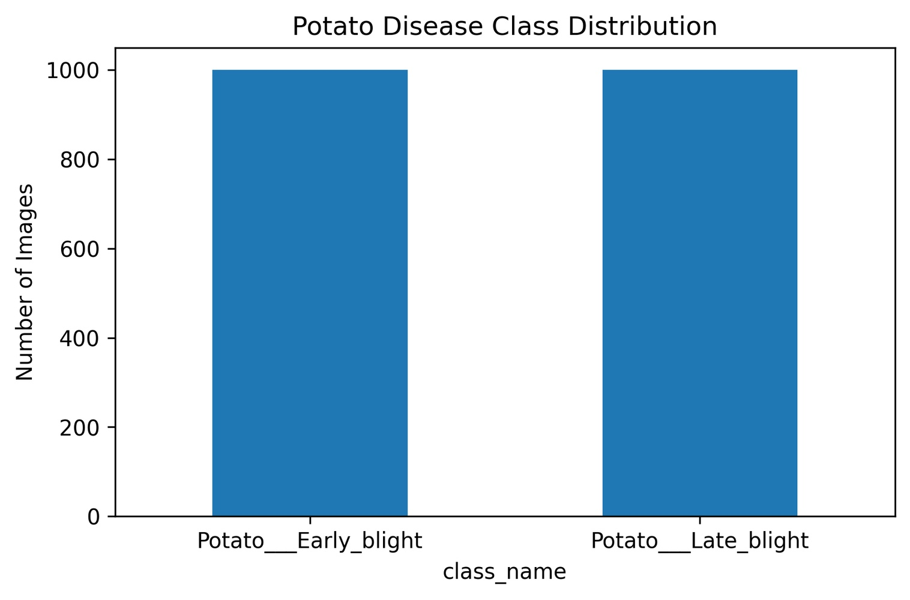
PRT661 · DATA SCIENCE PRACTICE
3
Balanced dataset and fixed split
TOTAL
EARLY BLIGHT
LATE BLIGHT
LEAF GROUPS
2,000
1,000
1,000
500
RGB images
balanced class
balanced class
group-aware audit
Train / validation / test = 1,400 / 300 / 300 · 350 / 75 / 75 disjoint leaf groups · zero shared groups

Slide 5
PRT661 · DATA SCIENCE PRACTICE
4
Implemented workflow
1
Audit
2
Split
3
Transform
4
Train
Folders, classes, dimensions and files
Group-disjoint 350 / 75 / 75 leaf groups
224×224; training-only augmentation
Logistic + PotatoCNN + MobileNetV2
5
Select
6
Test
7
Diagnose
8
Communicate
Validation-only checkpoints + thresholds
Locked PlantVillage + untouched PlantDoc tests
Errors, XAI, calibration, robustness and McNemar
Versioned evidence interface and report

Slide 6
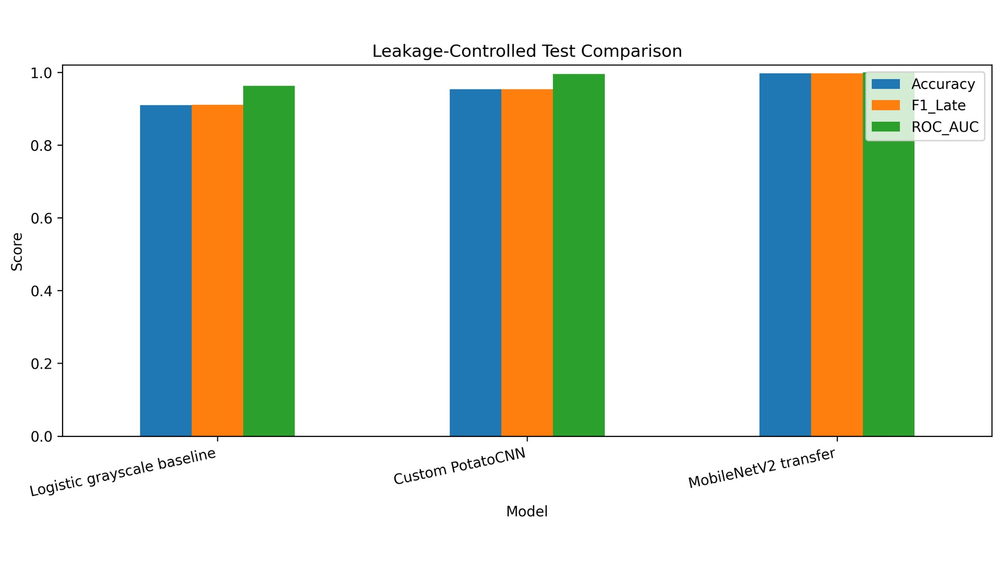
PRT661 · DATA SCIENCE PRACTICE
5
Three-model design
• Logistic grayscale baseline · traditional reference · threshold 0.70.
• PotatoCNN · 93,377 parameters · 224×224 RGB · threshold 0.38.
• MobileNetV2 · ImageNet transfer learning with staged fine-tuning · threshold 0.64.
• All operating thresholds were selected from validation data before test evaluation.

Slide 7
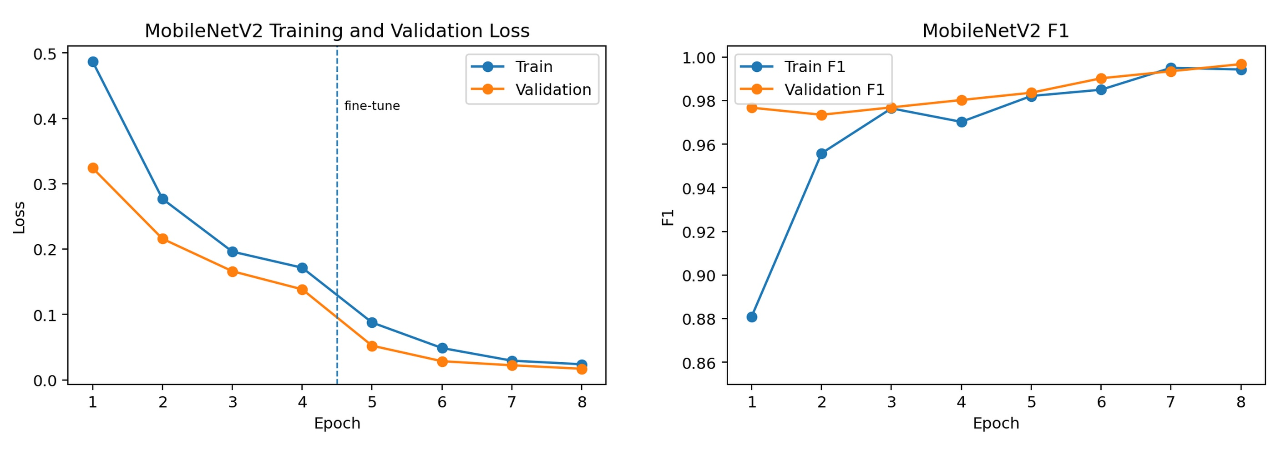
PRT661 · DATA SCIENCE PRACTICE
6
MobileNetV2 training and checkpoint selection
EPOCHS
BEST VAL F1
VAL LOSS
LOCKED THRESHOLD
8
0.9967
0.0169
0.64
head + fine-tune
epoch 8
final fine-tune stage
validation-only selection

Slide 8
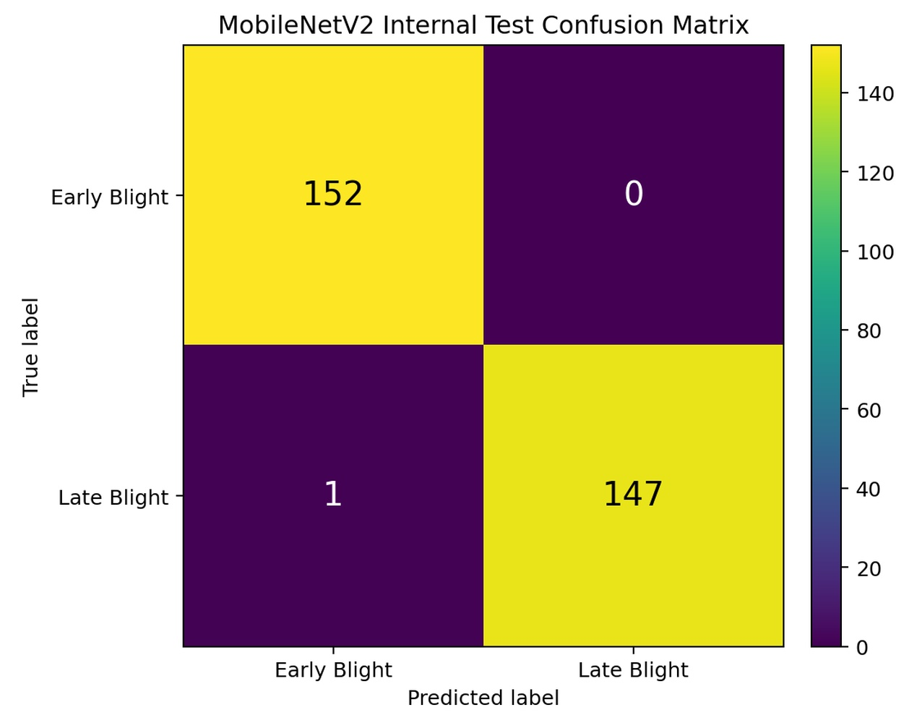
PRT661 · DATA SCIENCE PRACTICE
7
Primary MobileNetV2 held-out result
ACCURACY
PRECISION
RECALL
ROC–AUC
99.67%
100.00%
99.32%
1.0000
299 / 300
Late-Blight predictions
147 / 148 Late
group-isolated internal set
One error: 1 Late→Early · 0 Early→Late

Slide 9
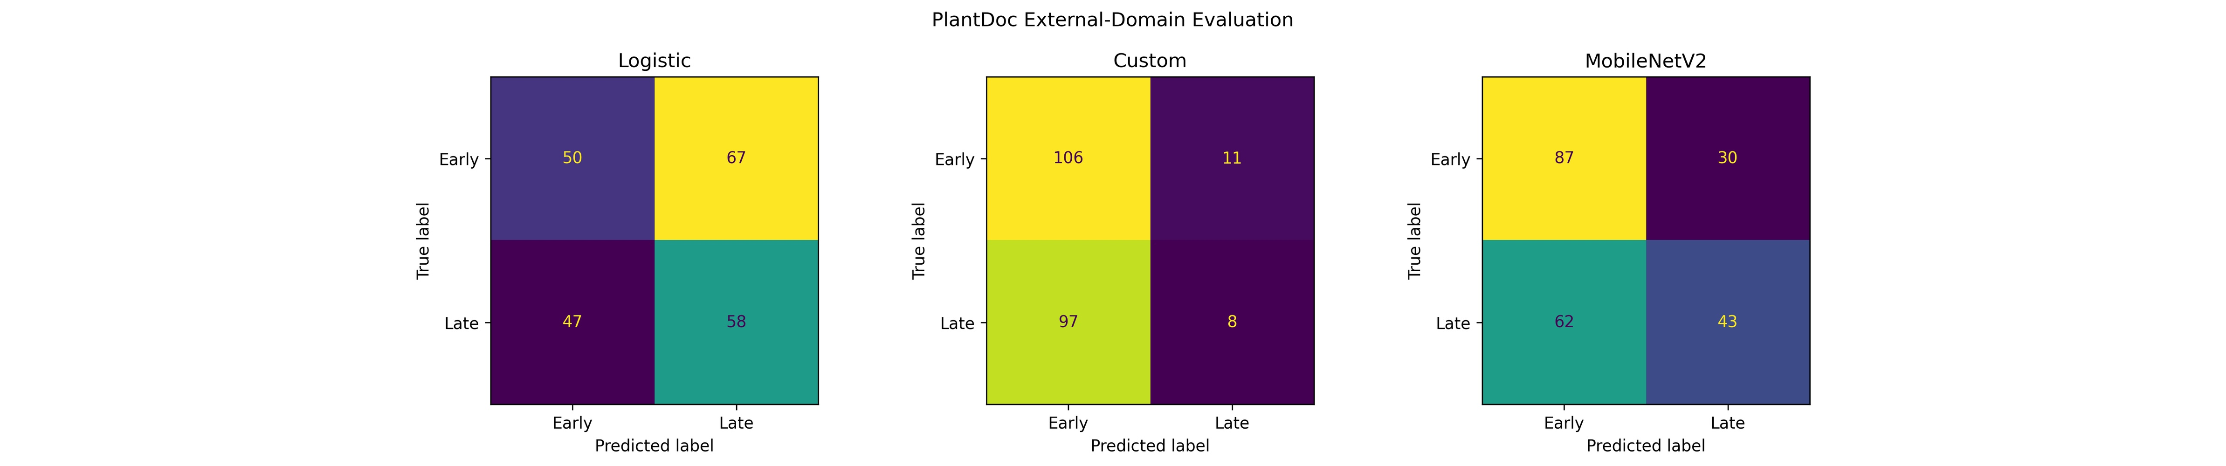
PRT661 · DATA SCIENCE PRACTICE
8
Untouched PlantDoc external evaluation
• 222 external PlantDoc images were evaluated with no fitting, retuning or threshold selection.
• MobileNetV2: accuracy 0.5856 · Late F1 0.4831 · ROC–AUC 0.6210.
• PotatoCNN: accuracy 0.5135 · Late F1 0.1290; logistic accuracy 0.4865.
• The large internal-to-external drop defines the main domain-generalisation limitation.

Slide 10
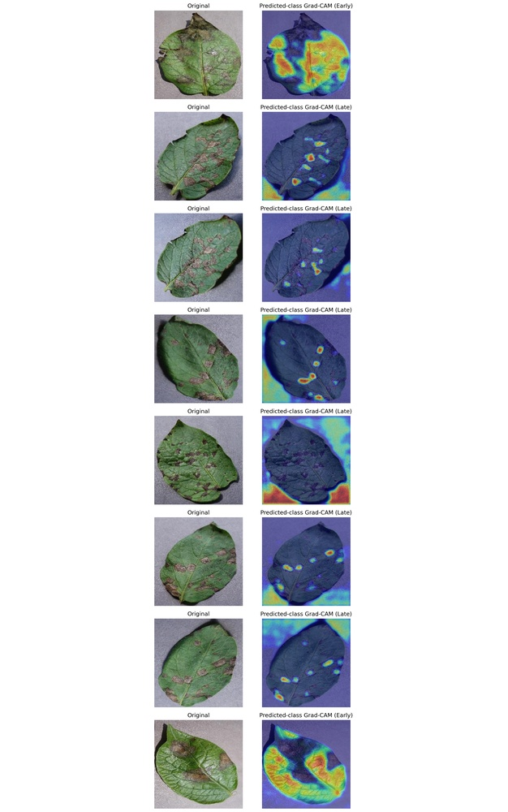
PRT661 · DATA SCIENCE PRACTICE
9
Explainability and internal error review
• Grad-CAM highlights regions influencing the class score in representative cases.
• Attention often overlaps lesions but can also include edges, background and broad leaf structure.
• PCA/t-SNE provide exploratory feature-separation views inside the controlled source.
• Heatmaps are diagnostic evidence—not pathogen confirmation or causal lesion localisation.

Slide 11
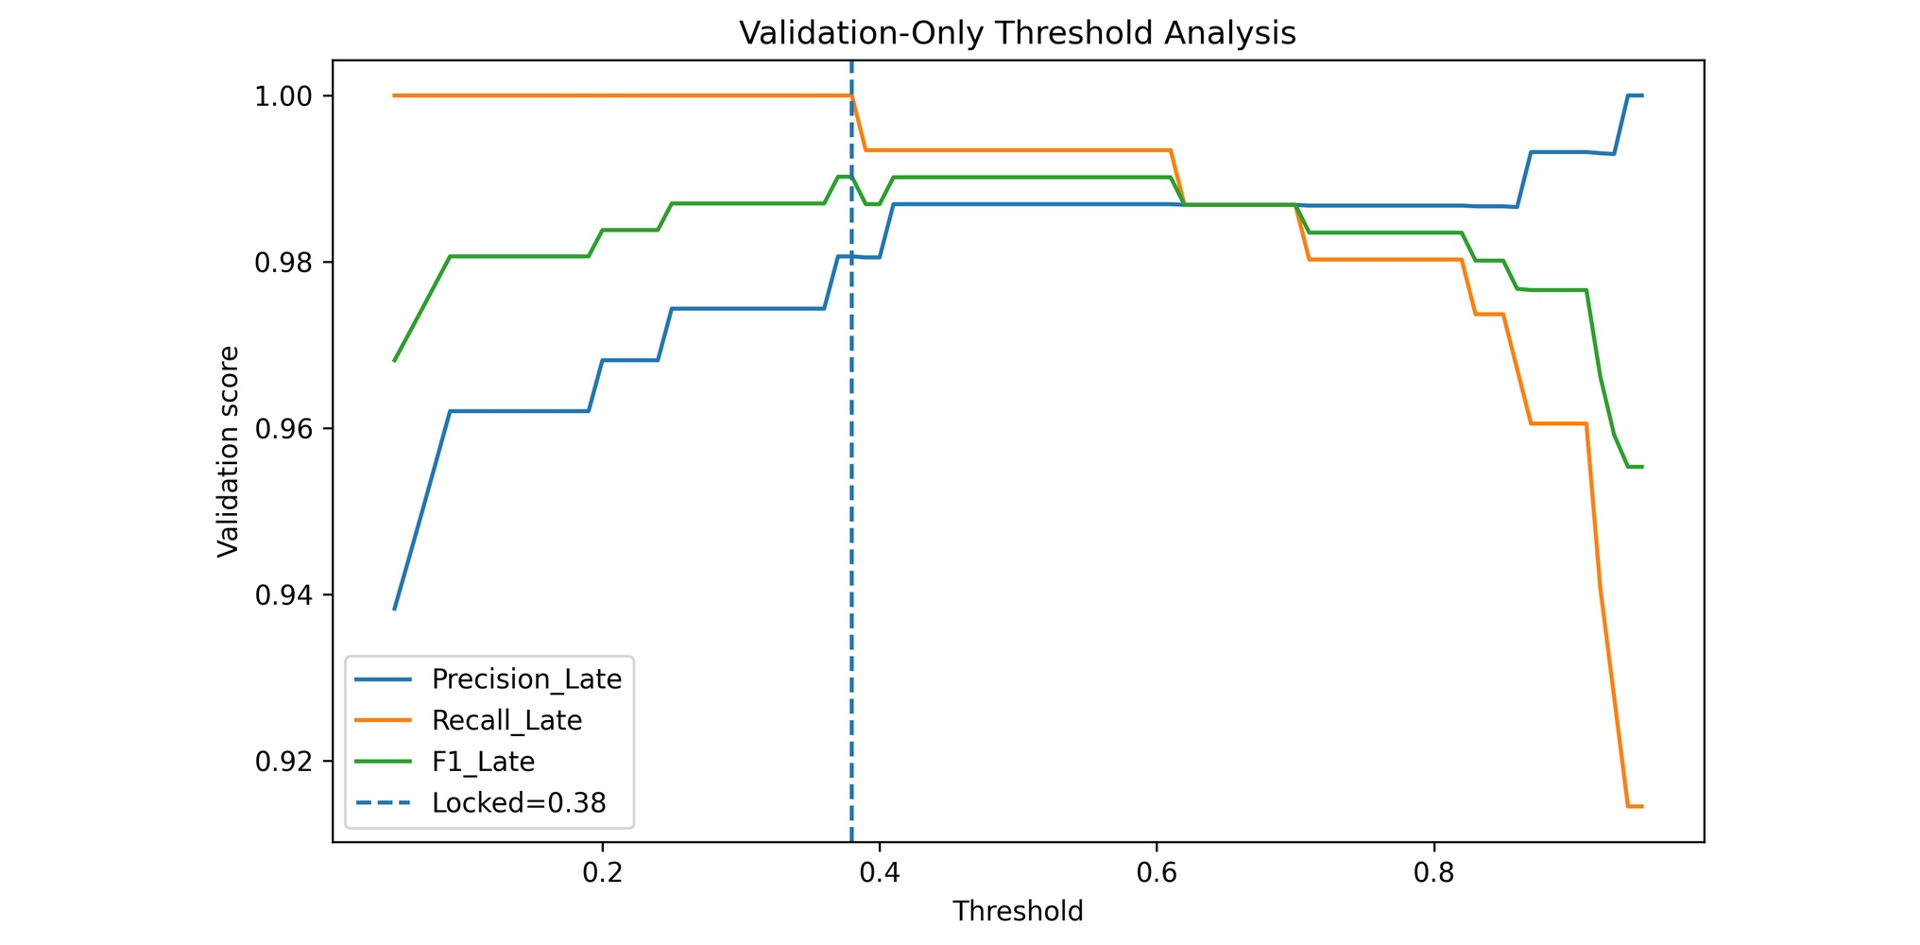
PRT661 · DATA SCIENCE PRACTICE
10
Validation thresholds and paired evidence
• Locked thresholds: logistic 0.70 · PotatoCNN 0.38 · MobileNetV2 0.64.
• PotatoCNN threshold 0.38 was selected from validation data only; no PlantDoc tuning.
• McNemar: Logistic vs MobileNetV2 p=2.16×10⁻⁷; PotatoCNN vs MobileNetV2 p=0.00098.
• Threshold curves are diagnostic evidence, not permission for test-set optimisation.

Slide 12
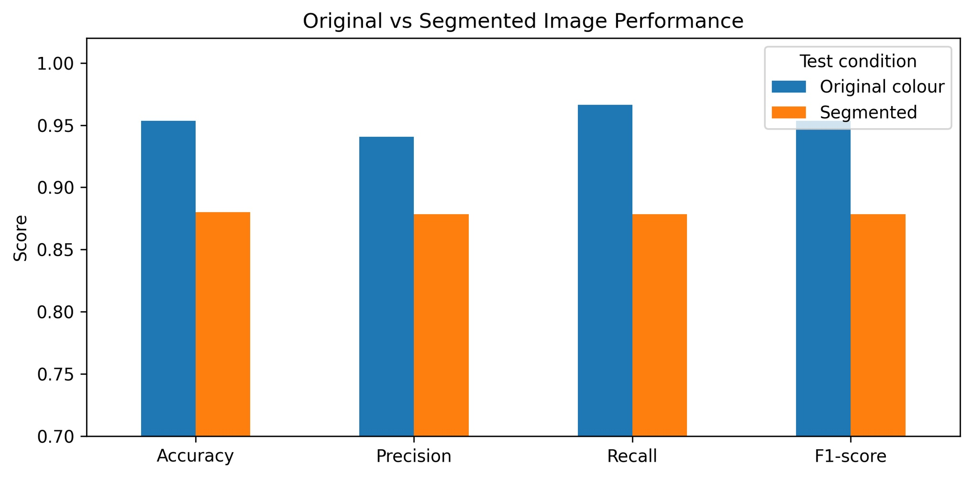
PRT661 · DATA SCIENCE PRACTICE
11
Segmentation exposed a probability shift
• At the ordinary 0.50 rule, segmented images produced no Late-Blight decisions.
• Segmented ROC–AUC remained 0.9566 despite the probability-scale shift.
• A threshold selected only on segmented validation recovered accuracy 0.8800 and F1 0.8784.
• Preprocessing + model + threshold must be validated and versioned as one system.

Slide 13
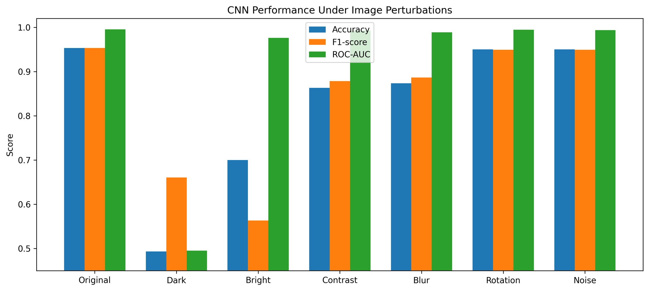
PRT661 · DATA SCIENCE PRACTICE
12
Controlled image perturbations
• Dark F1 0.6607 · Bright F1 0.5631.
• Contrast 0.8783 · Blur 0.8862.
• Rotation 0.9492 · Noise 0.9492.
• Strong ROC–AUC can coexist with poor fixed-threshold performance after distribution shift.

Slide 14
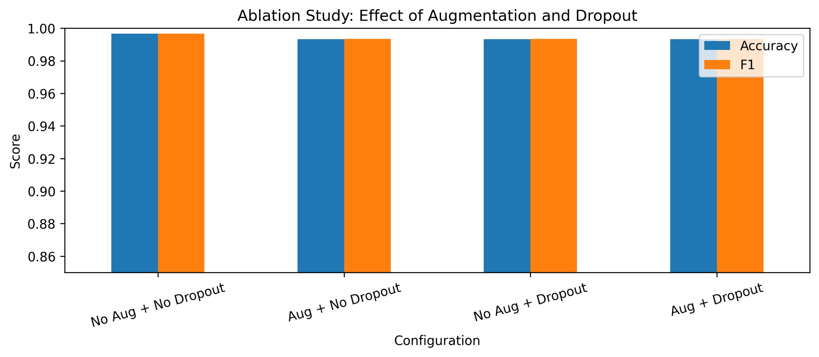
PRT661 · DATA SCIENCE PRACTICE
13
Ablation and efficiency
• Short ablations reached F1 0.9935–0.9967; the spread is about one test image.
• No strong augmentation/dropout architecture-winner claim is justified from that difference.
• PotatoCNN size: 0.360 MB · measured latency 0.819 ms/image · throughput 1,222 images/s.
• Efficiency supports prototyping; representative target-device benchmarking is still required.

Slide 15
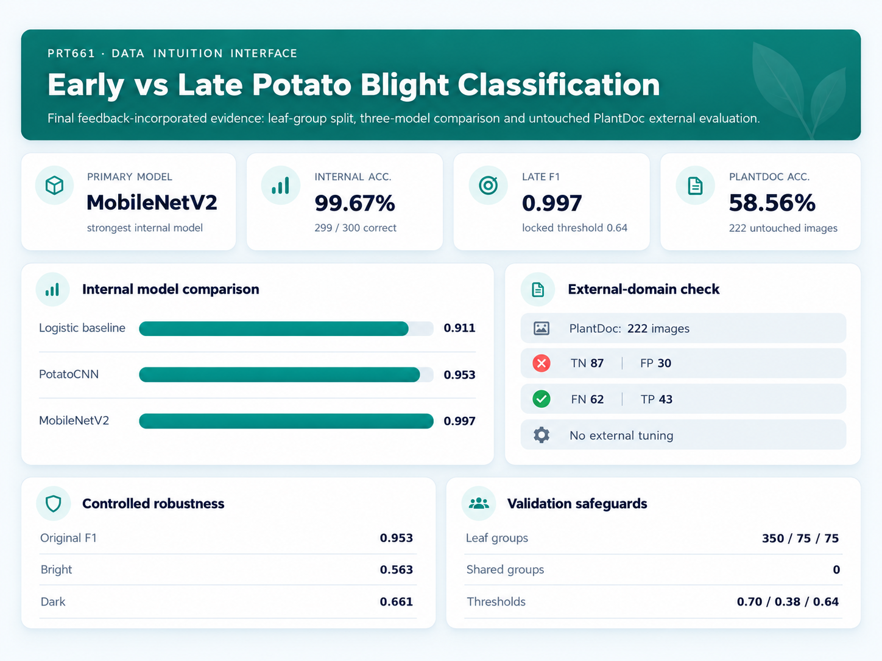
PRT661 · DATA SCIENCE PRACTICE
14
Feedback-integrated results explorer
LIVE DEMO
1
Compare models
2
Inspect PlantDoc
3
Review locked threshold
4
Review robustness

Slide 16
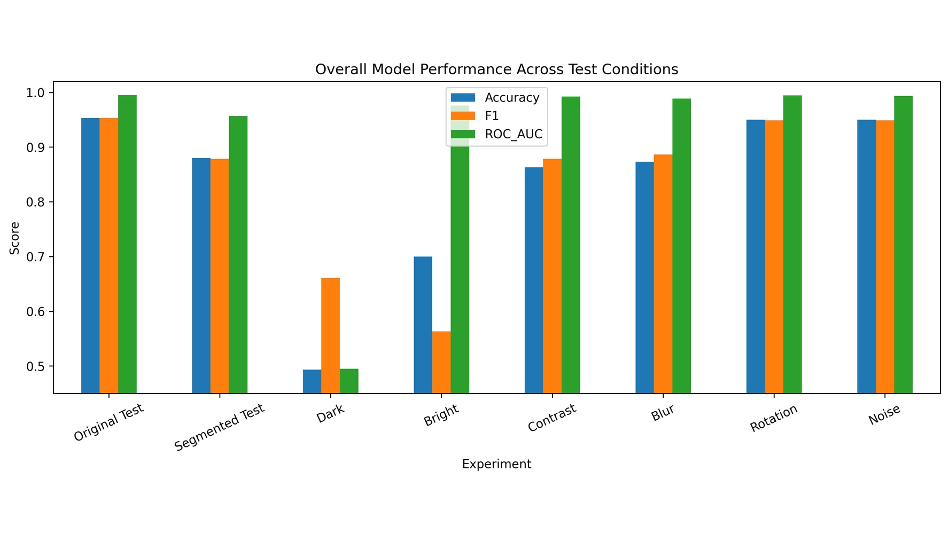
PRT661 · DATA SCIENCE PRACTICE
15
Ethics, privacy and security
• Two known disease labels do not equal field diagnosis or differential diagnosis.
• No pesticide, treatment or pathogen-confirmation output is produced.
• PlantDoc demonstrates external-domain weakness; field claims must remain explicitly limited.
• Uploads, model version, preprocessing and threshold require validation, logging and rollback.

Slide 17
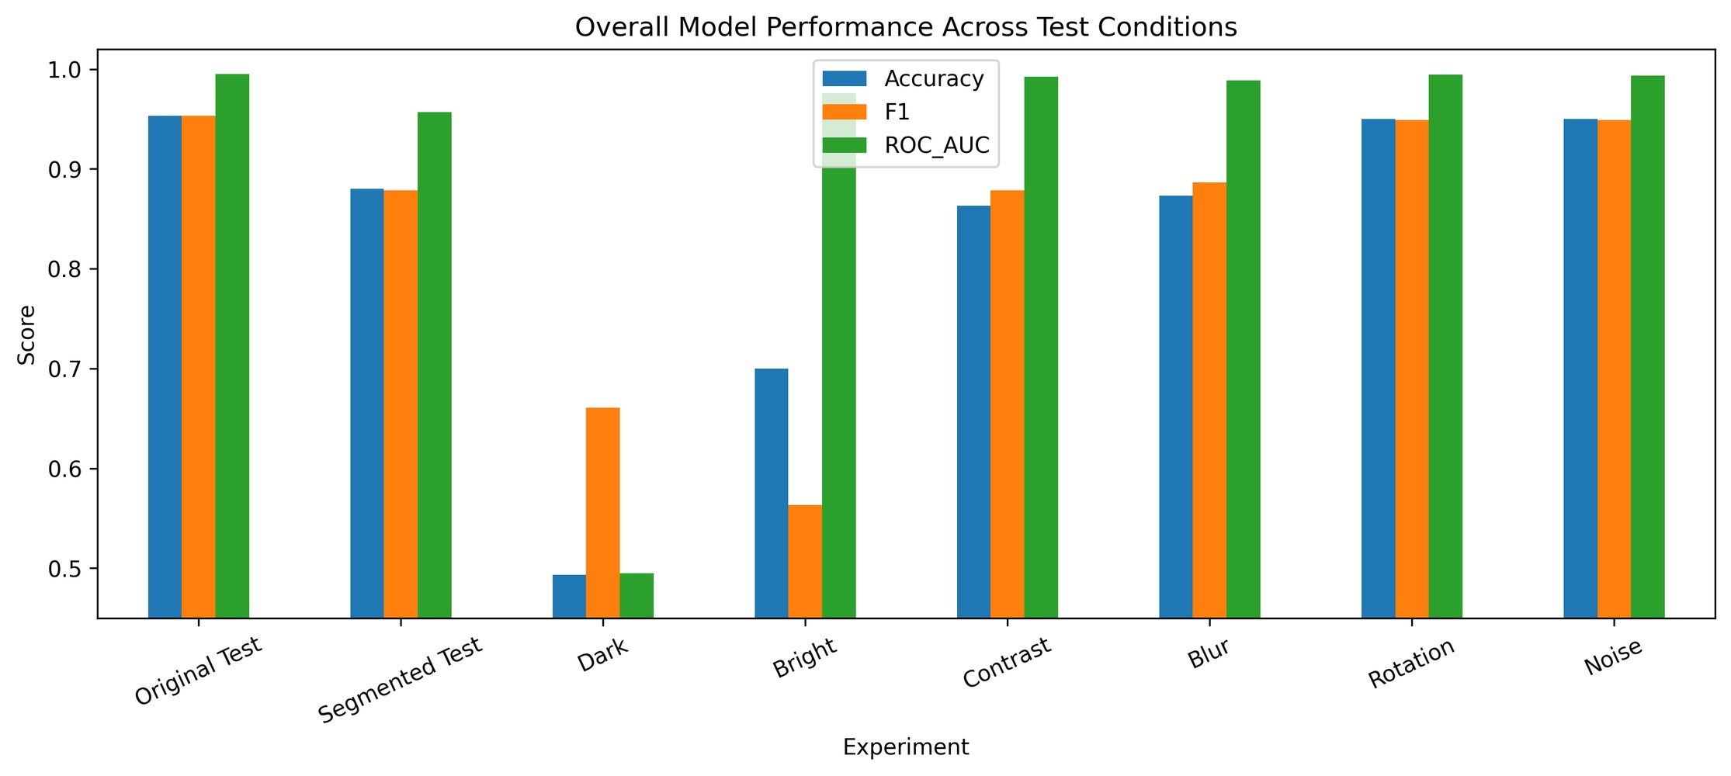
PRT661 · DATA SCIENCE PRACTICE
16
Implementation status and evidence gaps
• Complete: provenance, 500-leaf group split, logistic baseline, PotatoCNN and MobileNetV2.
• Complete: locked internal comparison, McNemar tests, XAI, calibration, segmentation, robustness, ablation and efficiency.
• Complete: untouched PlantDoc external evaluation plus versioned evidence/interface artefacts.
• Remaining submission items are team-specific links, contribution records and authentic project-management evidence.

Slide 18
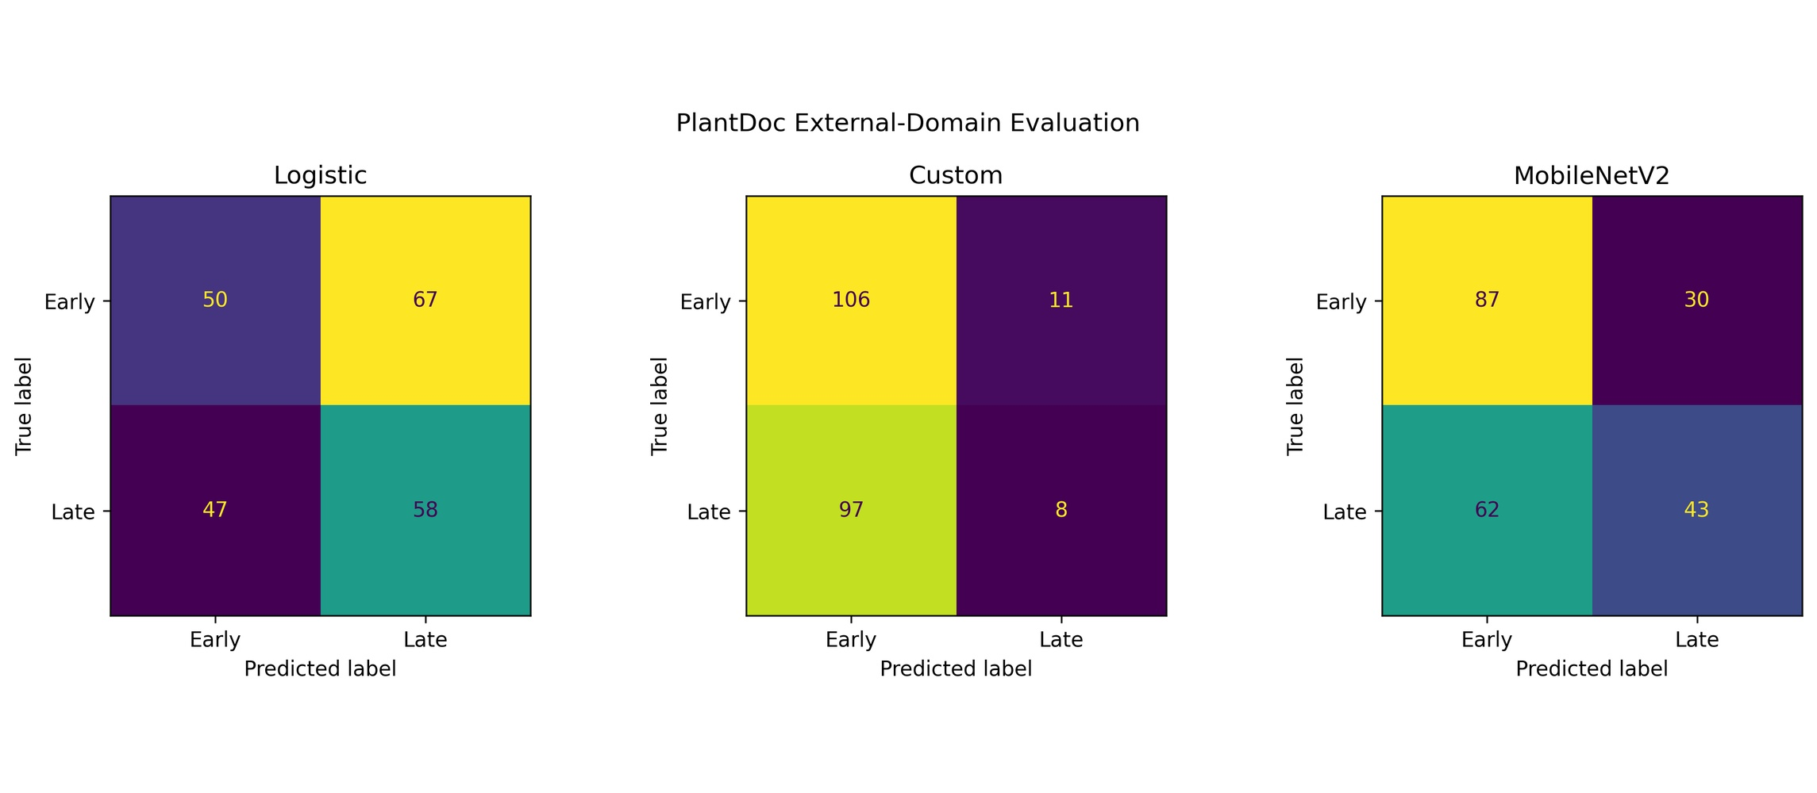
PRT661 · DATA SCIENCE PRACTICE
17
Prioritised next steps
• Collect prospective expert-labelled field images grouped by leaf, farm, device and site.
• Add Healthy, Other/Unknown and input-quality rejection or abstention.
• Keep preprocessing and thresholds versioned together; any representation change requires fresh validation.
• Calibrate prospectively, declare cost-based operating points and evaluate human review before field use.
Proof of concept

Slide 19
PRT661 · DATA SCIENCE PRACTICE
18
Future work
• Finalise authentic GitHub/Jira evidence and individual contribution records.
• Reproduce the full pipeline in a clean environment with versioned dependencies.
• Validate field/generalisation using grouped images by leaf, farm, device and site.
• Prepare Assessment 4 demo/report with human review, rejection and calibration limits.
Assessment 4

Slide 20
PRT661 · DATA SCIENCE PRACTICE
19
Conclusion
TEST ACCURACY
LATE RECALL
PLANTDOC ACC.
PLANTDOC F1
99.67%
99.32%
58.56%
0.4831
group-isolated internal set
147 / 148
222 untouched images
ROC–AUC 0.6210
TAKEAWAY
Excellent internal separation · weak PlantDoc transfer · field validation required before use

Slide 21
PRT661 · DATA SCIENCE PRACTICE
20
Selected references
Mohanty et al. (2016). Plant disease detection. Frontiers in Plant Science.
Hughes & Salathé (2015). PlantVillage repository announcement. arXiv.
Singh et al. (2020). PlantDoc: visual plant disease detection dataset. CoDS-COMAD.
Ferentinos (2018). Deep learning for plant disease. Computers and Electronics in Agriculture.
Sandler et al. (2018). MobileNetV2: inverted residuals and linear bottlenecks. CVPR.
Selvaraju et al. (2017). Grad-CAM. ICCV.
Guo et al. (2017). Neural-network calibration. ICML.
Hendrycks & Dietterich (2019). Corruption robustness. ICLR.

